Slide 1
pointnetVLAD & patch netvlad
2022.10.06
강경수

Slide 2
pointnetVLAD
2 /

Slide 3
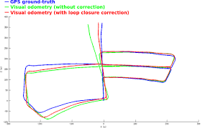
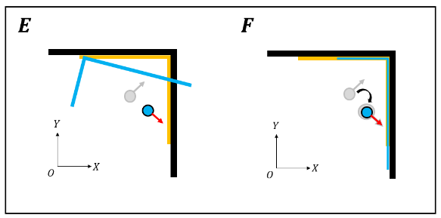
Topic – netVLAD from point cloud
3 /
- Global place recognition from Point cloud
GPS
ICP
2 stage loop closing Using GPS
Place recognition for GPS
ICP (overlap)
How to Global recognition in only point cloud

Slide 4
Motivation & contribute
4 /
- pointNetvlad
using NetVLAD in only point cloud
Contribution (1). Paper prove that netVLAD can use point cloud feature
- netVLAD is symmetric function → Permutation Invariance
(2). New loss function (lazy triplet, lazy quadruplet)

Slide 5
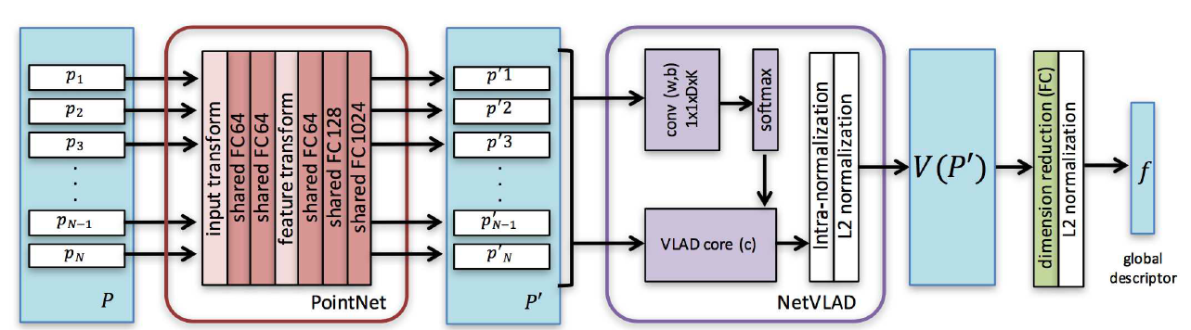
pointnetVLAD
5 /
- overview
pointNet
Make VLAD Vector
(pooling)

Slide 6
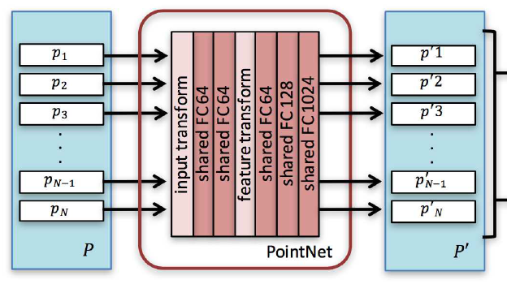
pointnetVLAD
6 /
- pointnet
P = {P1,…}, P ϵ R3
P` = {P`1,…}, P` ϵ Rx
Point cloud → pointNet → point cloud feature
PointNet is similar role that CNN architecture

Slide 7
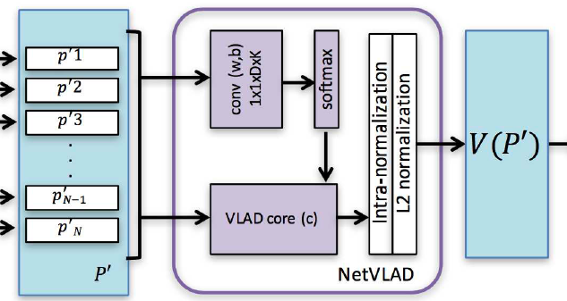
pointnetVLAD
7 /
- Point feature & netVLAD
Point feature is permutation invariance
If want to using netVLAD into pointcloud,
netVLAD should must symmetric fuction

Slide 8
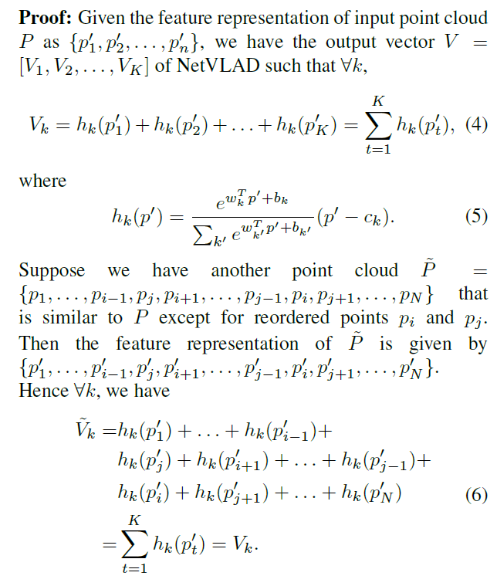
pointnetVLAD
8 /
- Point feature & netVLAD
NetVLAD module output is order invariant

Slide 9
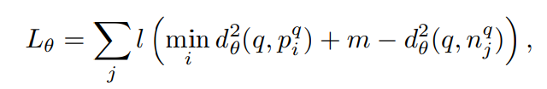

pointnetVLAD
9 /
- Lazy triplet & quadruplet
Original Netvlad loss function
Lazy triplet
Lazy quadruplet
Faster than original triplet & quadruplet

Slide 10
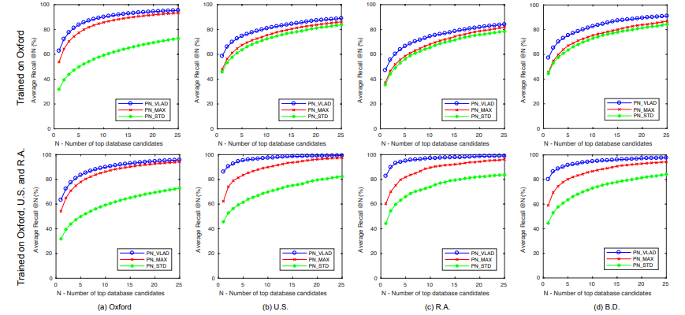
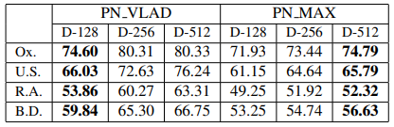
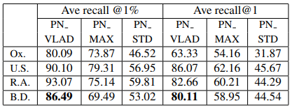
pointnetVLAD
10 /
- Experiments

Slide 11
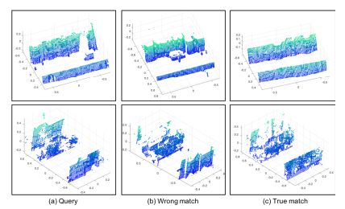
pointnetVLAD
11 /
- limitation
Fail with similar feature & occluded areas

Slide 12
Patch - netVLAD
12 /

Slide 13
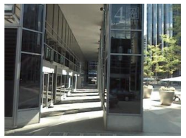
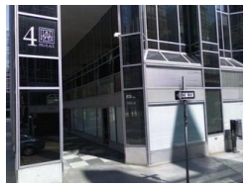
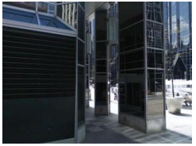
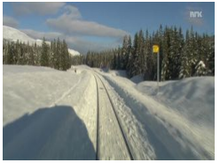
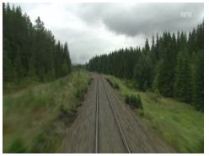
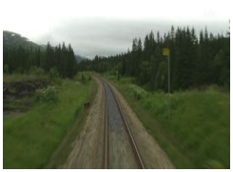
Topic – improvement netVLAD
13 /
- Limitation of netvlad
Query
netVLAD
Ground truth
View point & local image matching error
Only global(all pixel) VLAD vector

Slide 14
Topic – improvement netVLAD
14 /
- How to improve netvlad
Global place recognition with Netvlad
Candidate image search by netVLAD
verification using local feature (SIFT) → replace from local feature to patch(small) - netVLAD
2 stage verification method
→ 1 stage verification method(only use patch - netVLAD)

Slide 15
Motivation & contribute
15 /
- Patch NetVLAD
Combine global & local feature to patch netVLAD
Contribution (1). multi-scale fusion technique that generates and combines
(2). novel place recognition system
- compare each patch size VLAD vector

Slide 16
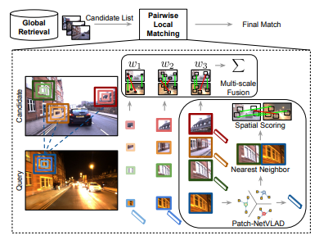
Patch - netVLAD
16 /
- overview
image
Candidate search
(global VLAD vector)
Geometric verification
(local VLAD vector)

Slide 17

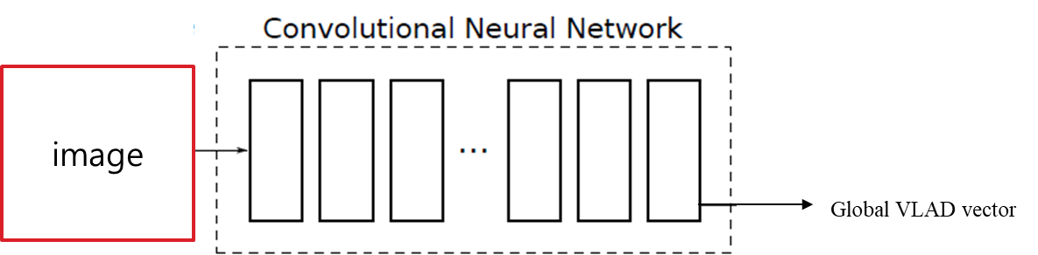
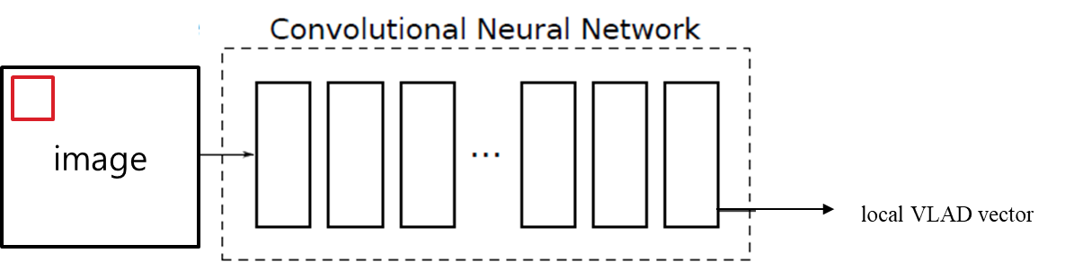
Patch - netVLAD
17 /
- Global & local

Slide 18
Patch - netVLAD
18 /
- Search & special scoring
Candidate
Image
&
Local descriptor
Global
descriptor
matching
image
NN search
NN search,
Spatial score

Slide 19
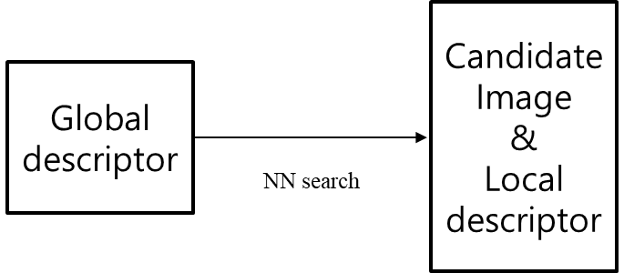
Patch - netVLAD
19 /
- Search & special scoring
image
query
image
image
Find candidate

Slide 20
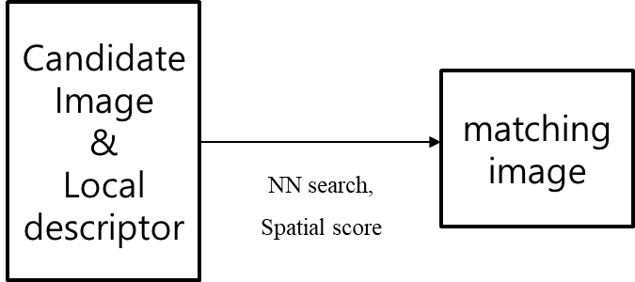
Patch - netVLAD
20 /
- Search & special scoring
Matching local descriptor by
NN search

Slide 21
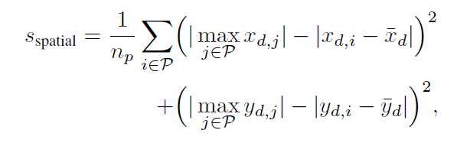
Patch - netVLAD
21 /
- Search & special scoring
1). RANSAC
2). Rapid Spatial Scoring
Geometric verification
find Highest spatial score

Slide 22
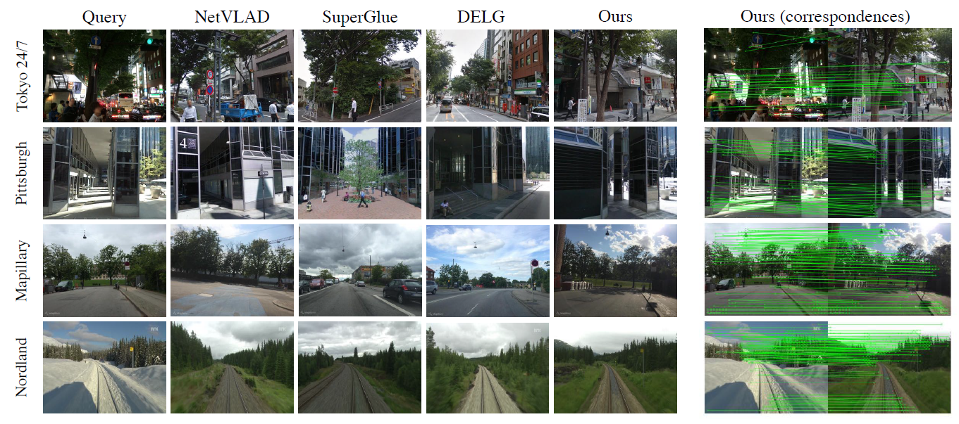
Patch - netVLAD
22 /
- Experiments

Slide 23
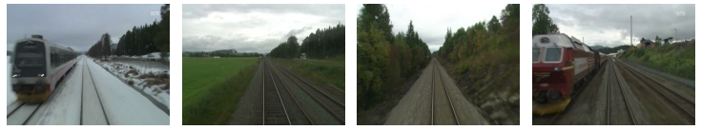
Patch - netVLAD
23 /
- Experiments (limitation)
query
Ground truth
Super GLUE
Patch netvlad

Slide 24
Q & A.
24 /

